Slide 1
Build your own IoT

Slide 2
What is IoT?

Slide 3
measuring controlling listening seeing displaying

Slide 4
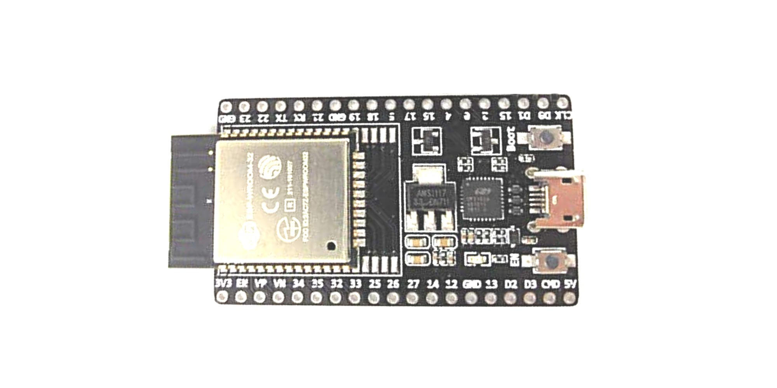
ESP32

Slide 5
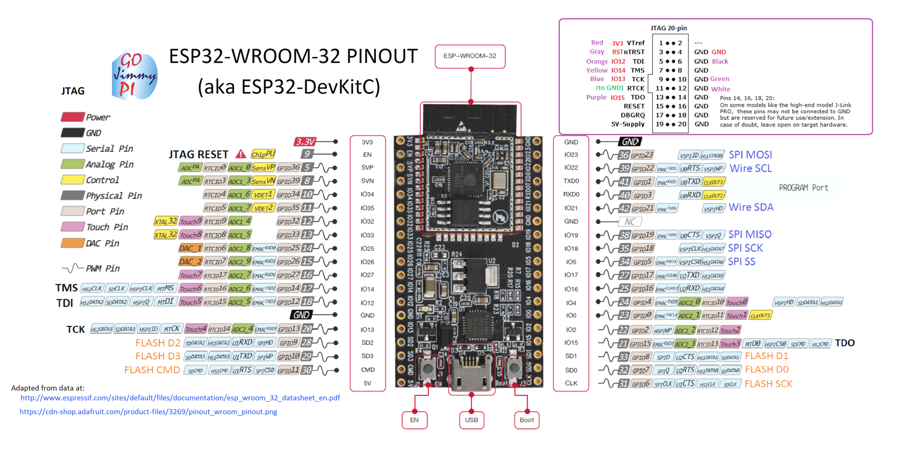

Slide 6
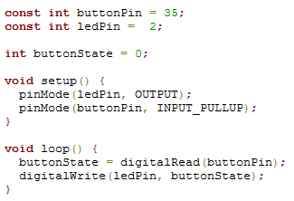
Arduino IDE
C(++) for code
API for inputs/outputs
Libraries for most things
One button upload
Debugging via LED or println()

Slide 7

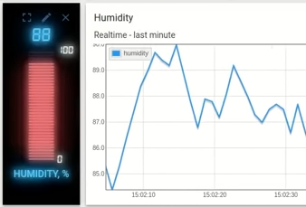
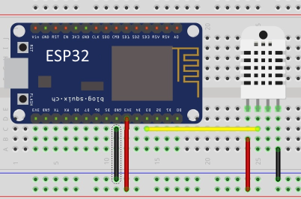
Thingsboard – IoT platform

